Slide 1
Bioreactor
Team №32:
Team leader: Sanzhar Yergaliev
Associate leader: Sabina Bekkul
Daniyar Zhakyp
Zangar Ermagambetov
Alimkhan Zhanturlin
Akerke Assetova
Amir Arystan
Damir Kalzhigitov

Slide 2
Name of the member | Contribution to the project
Sanzhar Yergaliev | Arduino coding + Assembling
Sabina Bekkul | Yeast production
Akerke Assetova
Damir Kalzhigitov | 3D modelling and printing
Zangar Ermagambetov
Daniyar Zhakyp | Report + Video/Image material
Amir Arystan
Alimkhan Zhanturlin | Test of the bioreactor

Slide 3
Outline
Calculations and a flow diagram of the control process
3D modelling
Code Implementation and Assembling
Yeast production process
Difficulties of the experiment

Slide 4
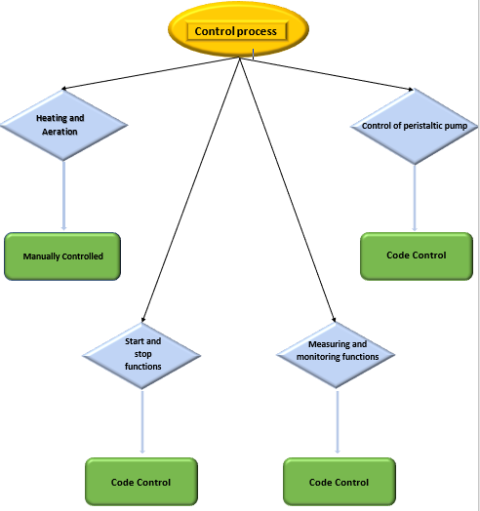
The flow diagram of the control process

Slide 5
Basic calculations
V (Impeller speed) = 155 RPM
In the water
At 10 Volts
Moment of inertia of the impeller = 1,95 * 10^-7 (kg*m^2)
We were not able to find the torque of the impeller as we did not determine the center of mass of the stirrer

Slide 6
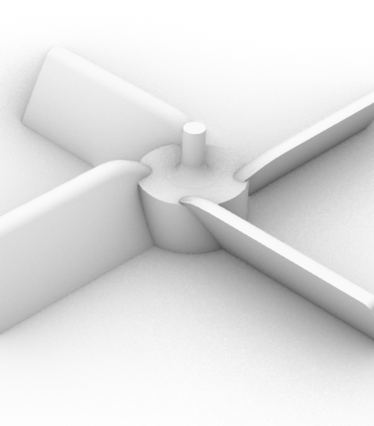
3D printing process
Particles for our project was modelled in Rhino
Overall, we printed three particles(impeller, coupler, detail to keep the DC motor stable)
Impeller inclination degree 45(to print without supporting structure)
Dimensions of impeller was calculated with the help of lecture slides on Mechanical Stirred Tanks

Slide 7
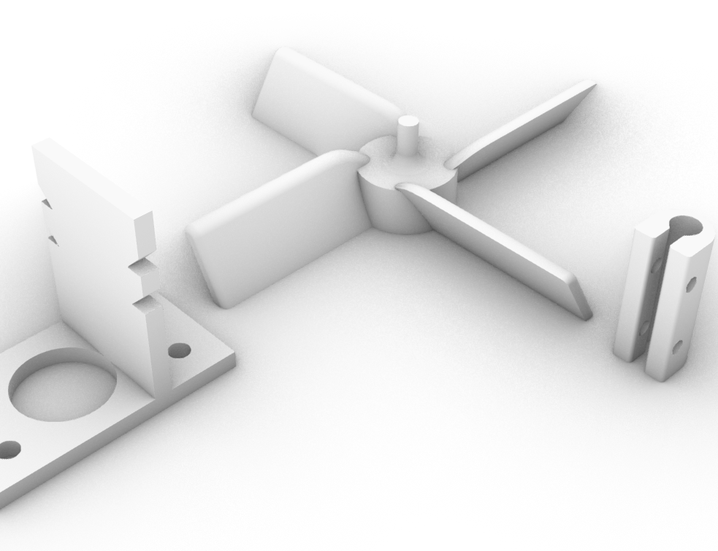
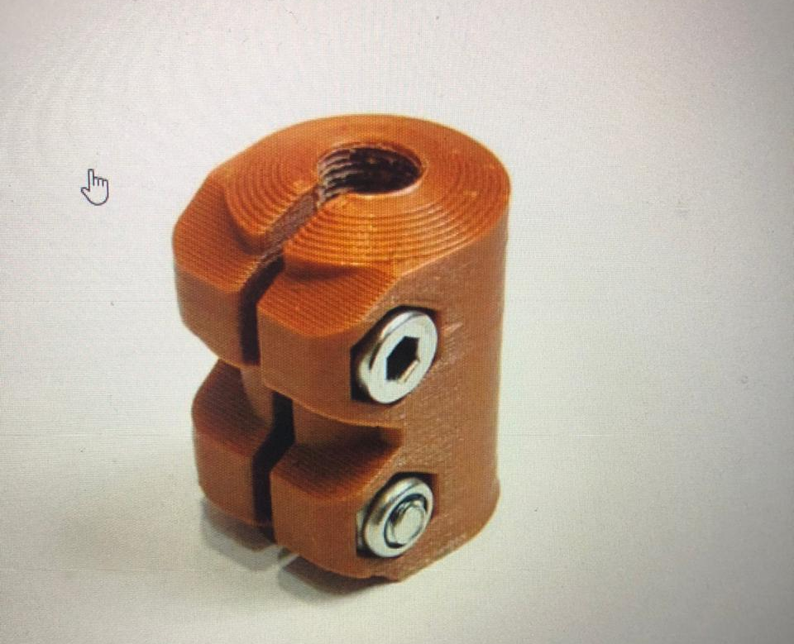
In detail for DC motor we made some changes for making printing process easier
However for coupler model we used the example derived from the Internet dimensions were calculated to make the connection stronger and economically beneficial

Slide 8
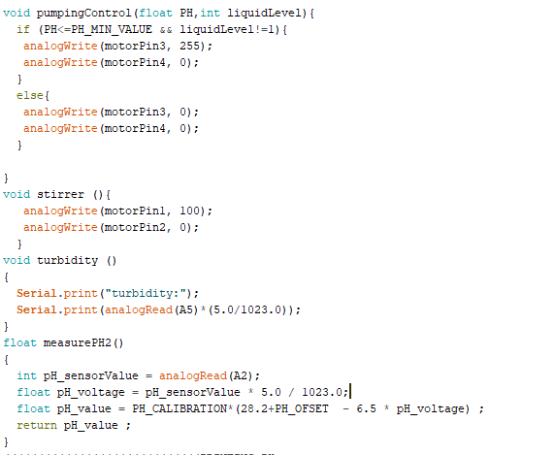
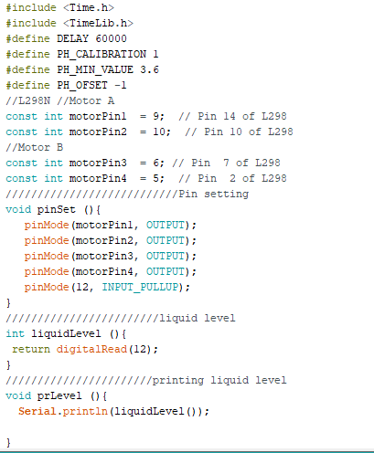
Code Implementation

Slide 9
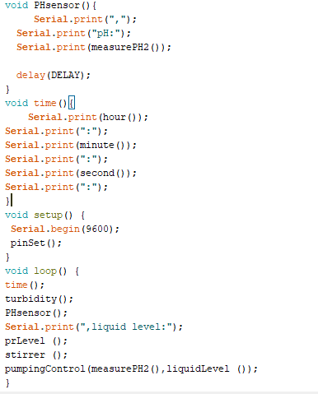

Slide 10
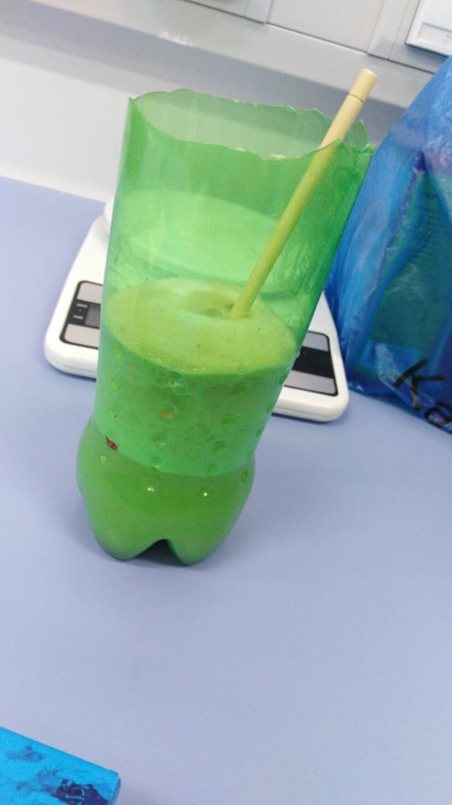
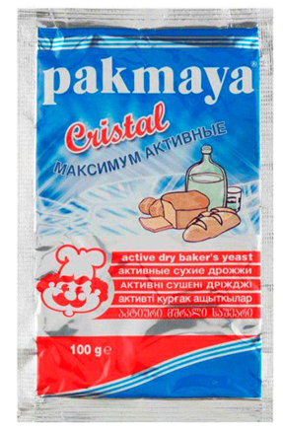
Preparation for the process
Medium recipe:
Potatoes – 500 g
Distilled water – 2.5 L
Inoculum:
Yeast – 7 g
Sugar – 63 g

Slide 11
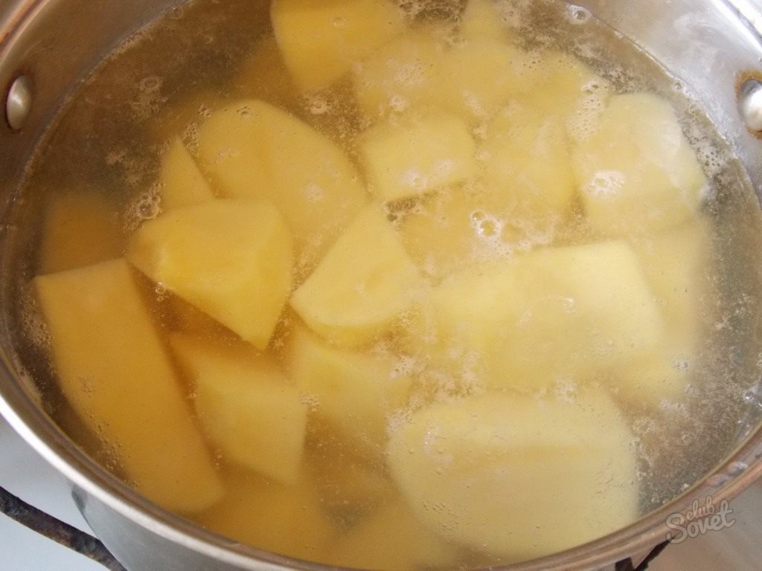
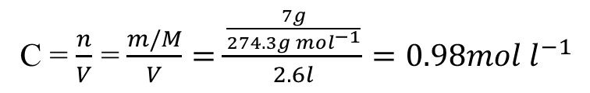
Process of yeast production
Potato was boiled in the distilled water for 1 hour
Filtered medium was poured into the bioreactor
Added sugar and then yeast
The concentration of total dry solid in the bioreactor found to be 0.98 mol/l:
C = $\frac{n}{V}$ = $\frac{m/M}{V}=\frac{\frac{7g}{274.3g {mol}^{−1}}}{2.6l}=0.98mol l^{−1}$

Slide 12
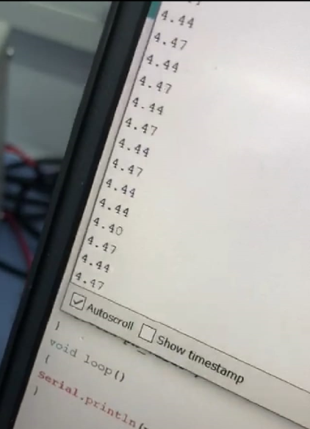
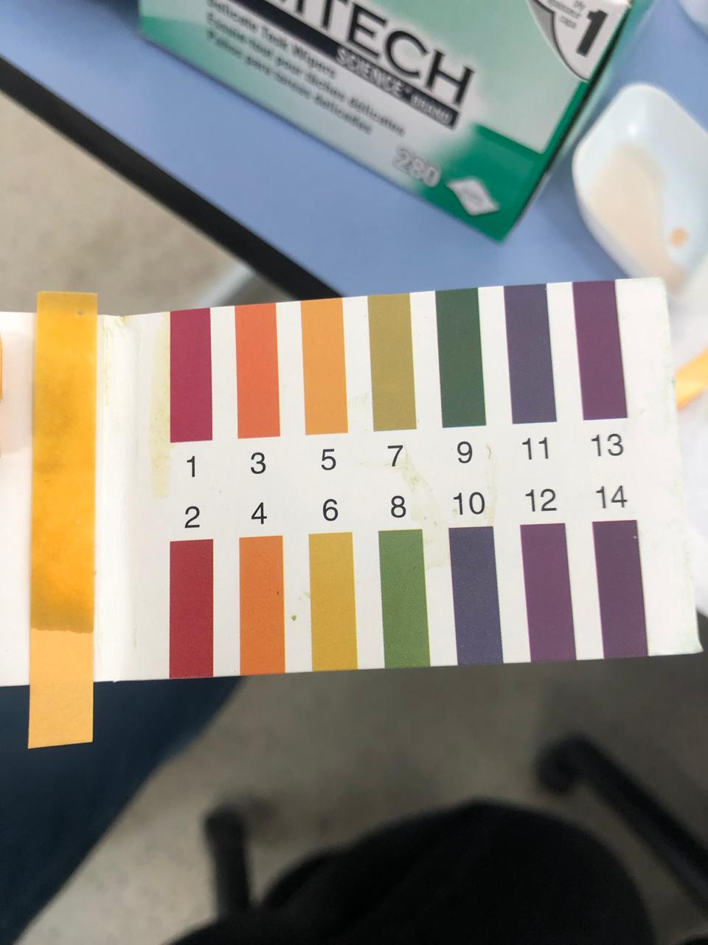
Obtaining of measurements (1)
For measurement of pH, we used universal indicator papers, along with pH sensor.
Measurements from pH sensor
Measurements from universal indicator papers

Slide 13
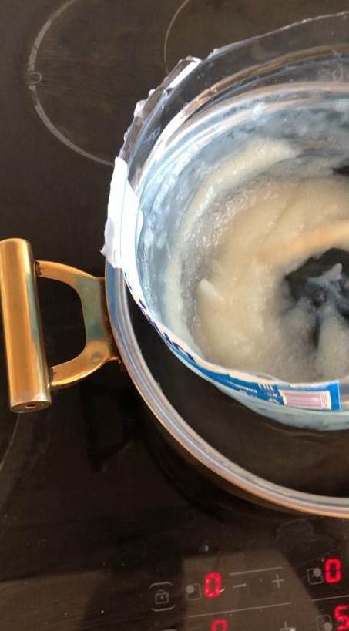
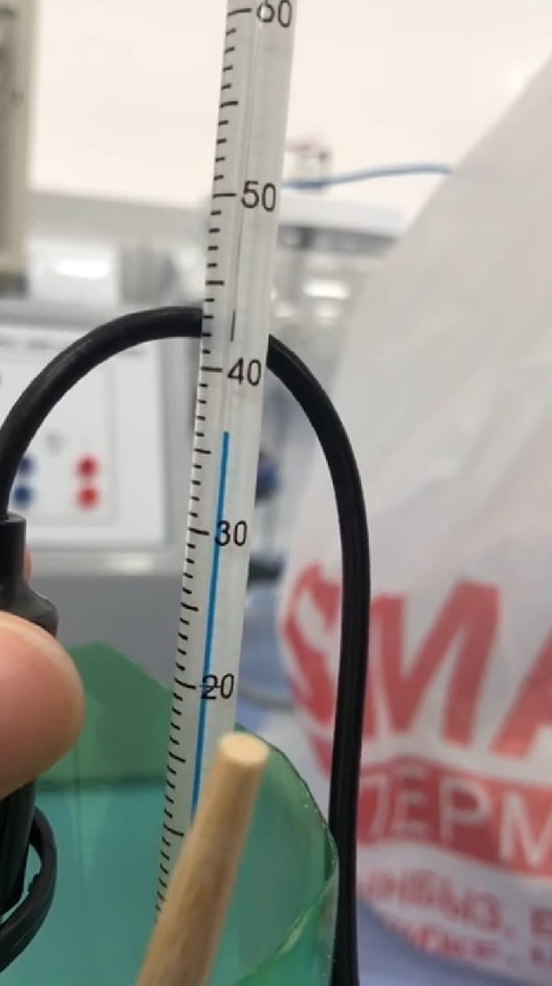
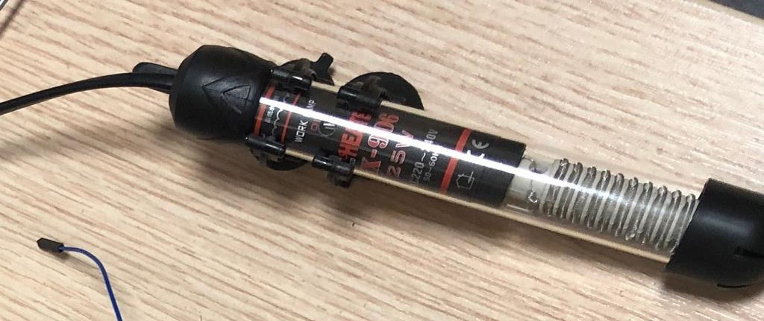
Obtaining of measurements (2)
We measured temperature using thermometer and were trying to achieve optimal temperature for the yeast growth, which is 34.5°C. The heating process has been maintained with the help of the heater provided.
Heater
Water bath
Thermometer

Slide 14
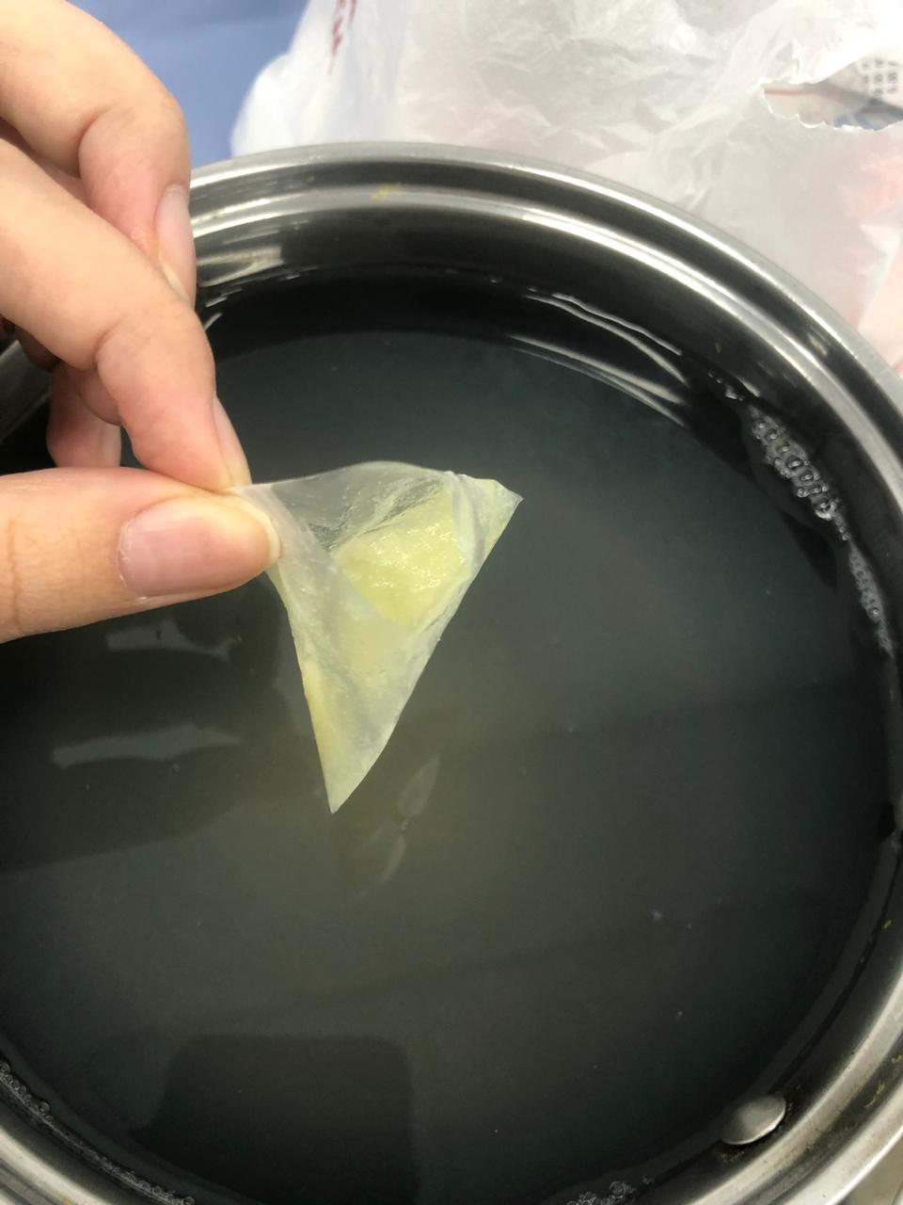
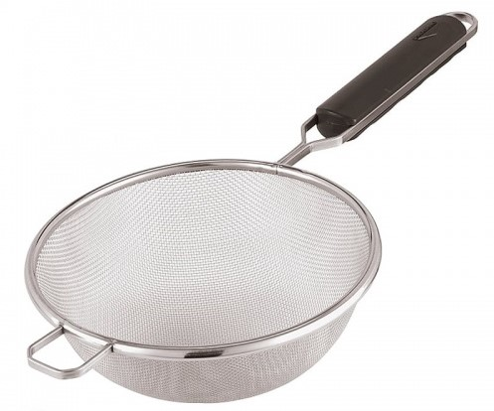
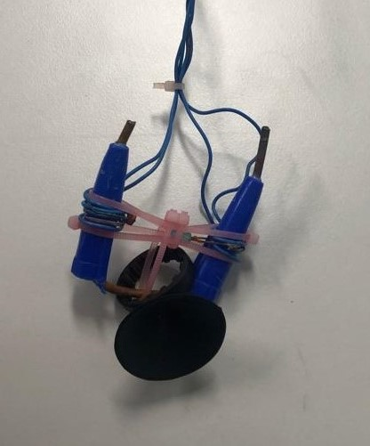
Obtaining of measurements (3)
We were controlling turbidity level using the turbidity sensor. To make the medium purer and remove tiny particles of potato we filtered it through tea strainer and then through tea bags.
Tea strainer
Tea bag
Turbidity sensor

Slide 15
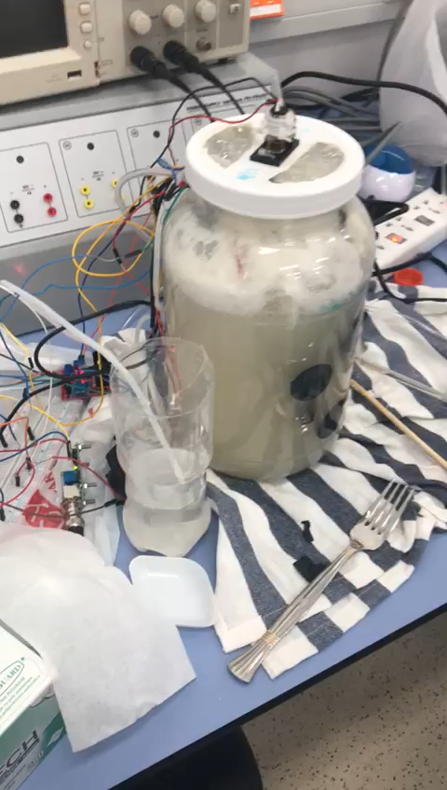

Slide 17
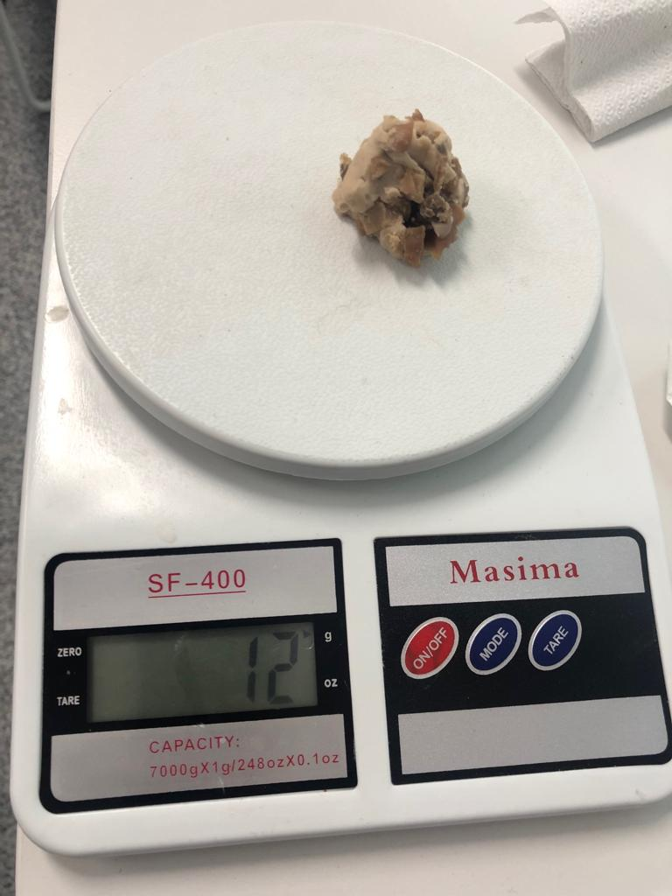
Results:
The yeast production phase went successfully. The whole process lasted for 7.5 hours. As a result, we could get 12 g of yeast from the bioreactor, while the initial mass of the yeast put was 7g.

Slide 18
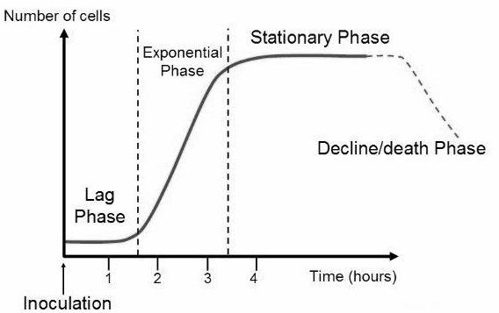

Calculation of the growth rate constant:
Growth rate constant (μ) is a rate of bacteria production during an exponential (log) phase.
$$μ=\frac{logN_{f} −logN_{i}}{t_{f} − t_{i}}=\frac{log⁡(2.63× {10}^{22}) −log⁡(1.55 × {10}^{22}) }{7.5hours}=0.031 {hrs}^{−1}$$

Slide 19
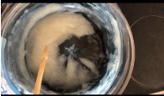
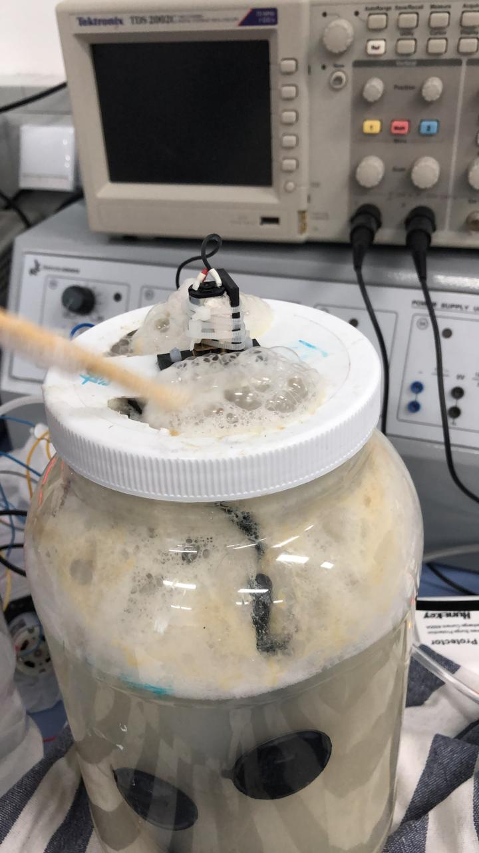
Difficulties
Many trials
Agar usage
Foam and bubbles, limiting the aeration
Halting of the pH sensor

Slide 20
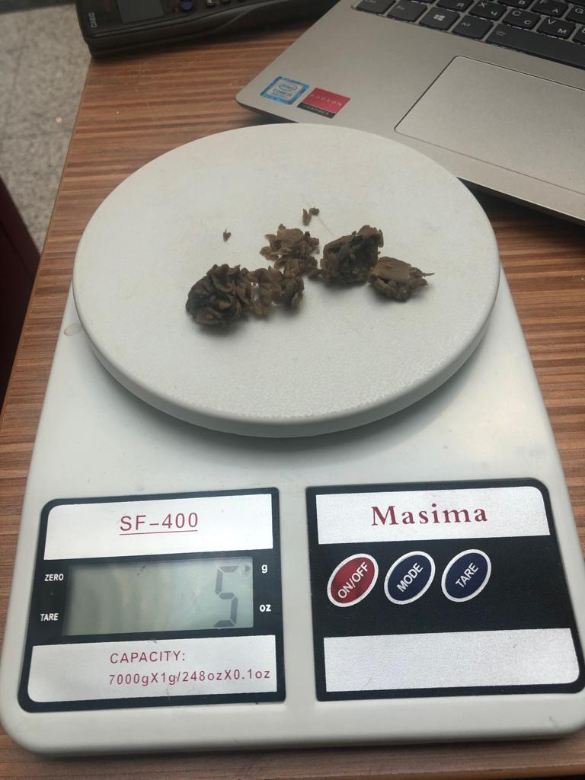
Comparison

